Slide 1
Finding inefficient parts of the bus route
12171976 park jihun

Slide 2
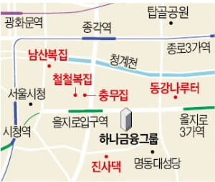
question
It takes 16 minutes to get to Eulji Station from Jonggak Station by subway and 6 minutes to walk.
Can we find these inefficient routes?
I tried using the bus route network
Jonggak Station
Eulji Station

Slide 3
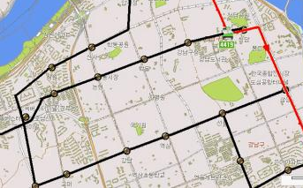
question
It is judged to be inefficient if the bus route distance is longer than the straight line distance.
What areas have inefficient routes?
Is there any way to move efficiently?
A
B

Slide 4
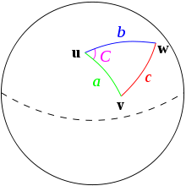
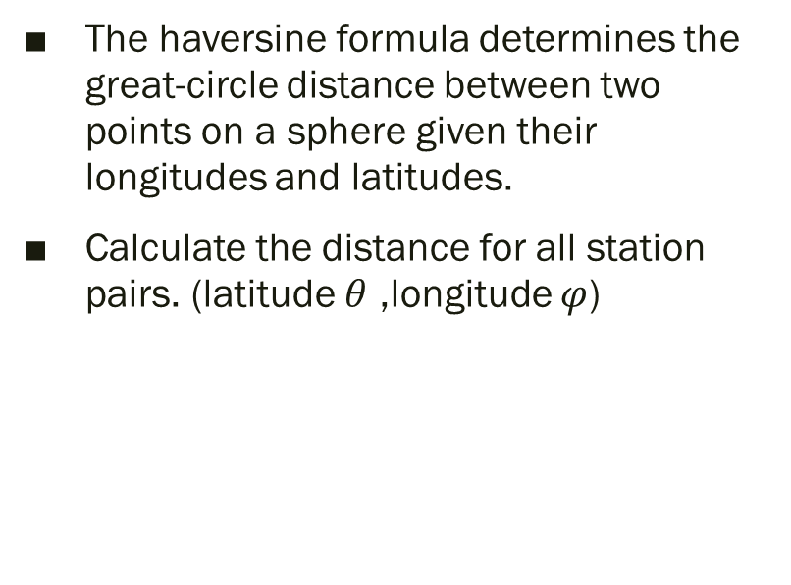
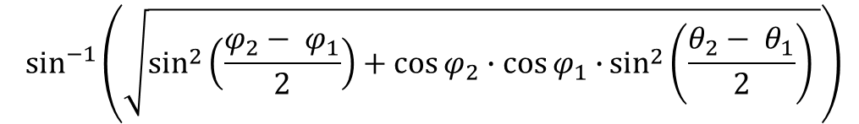
method
The haversine formula determines the great-circle distance between two points on a sphere given their longitudes and latitudes.
Calculate the distance for all station pairs. (latitude $θ$ ,longitude $φ$)
$$\sin^{−1}\left(\sqrt{\sin^{2}\left(\frac{φ_{2}− φ_{1}}{2}\right)+\cos{φ_{2}∙\cos{φ_{1}∙}}\sin^{2}\left(\frac{θ_{2}− θ_{1}}{2}\right) }\right)$$

Slide 5
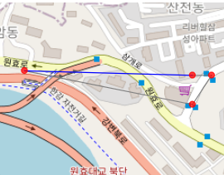
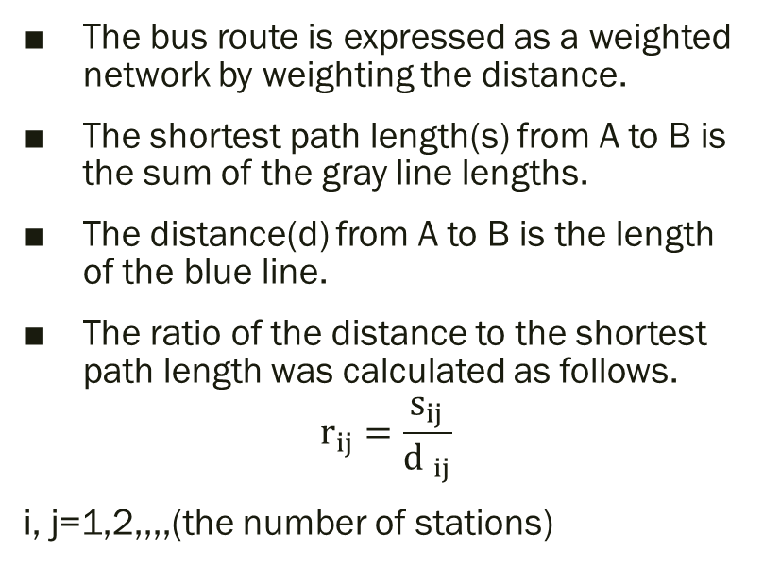
method
The bus route is expressed as a weighted network by weighting the distance.
The shortest path length(s) from A to B is the sum of the gray line lengths.
The distance(d) from A to B is the length of the blue line.
The ratio of the distance to the shortest path length was calculated as follows.
$$r_{ij}=\frac{s_{ij}}{{d }_{ij}}$$
i, j=1,2,,,,(the number of stations)
A
B

Slide 6
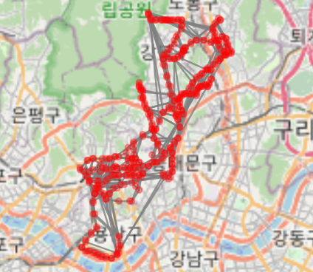
results
Red dot means station.
The gray line means the bus line.

Slide 7
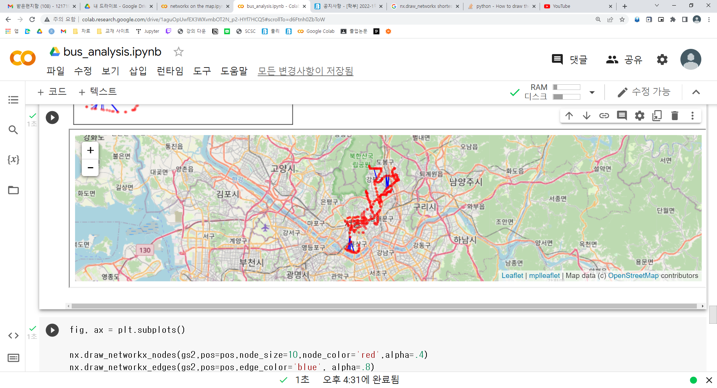
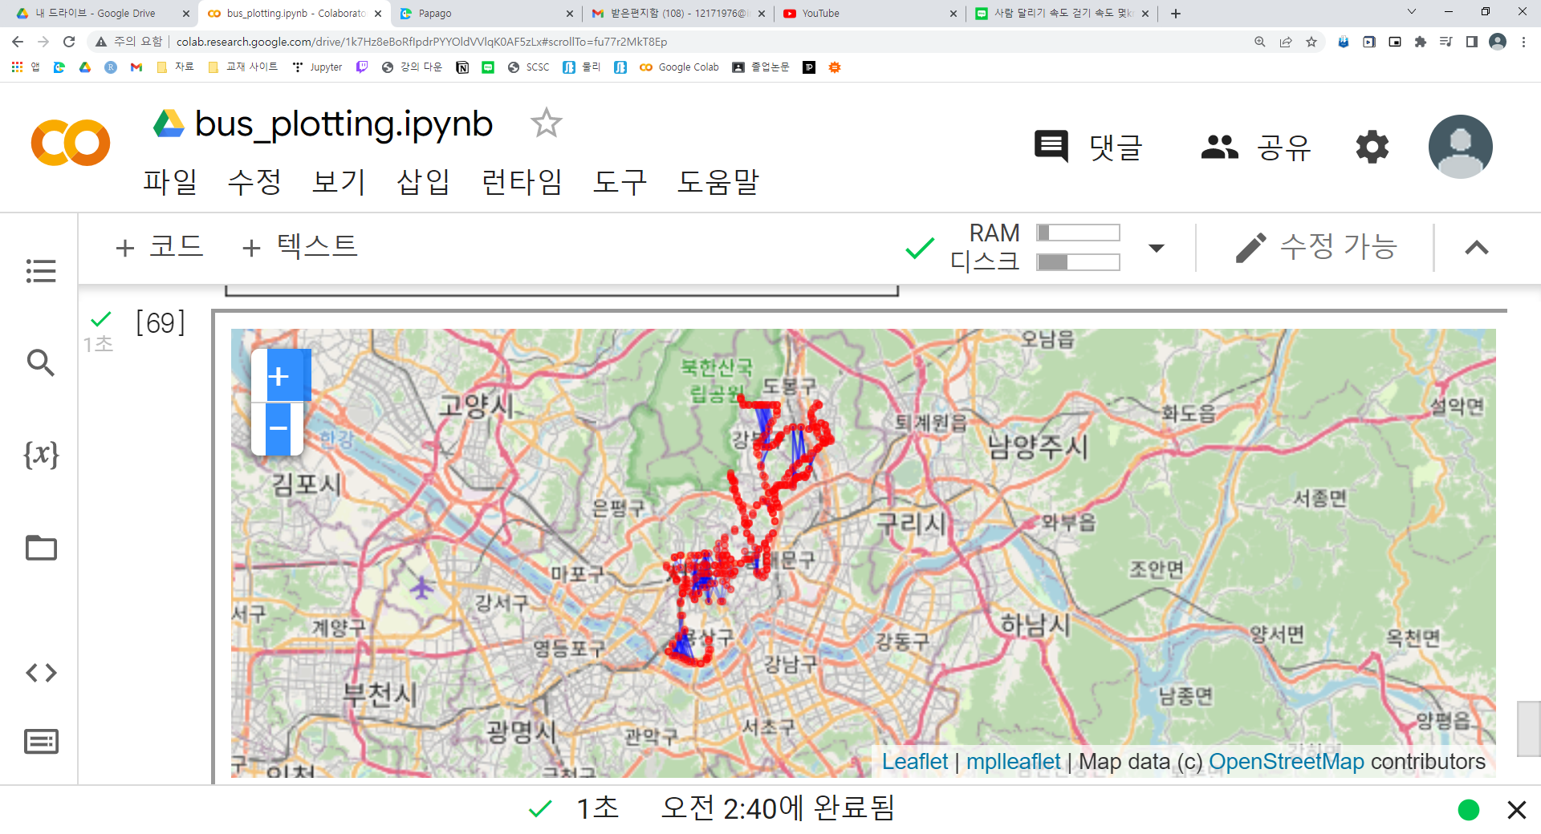
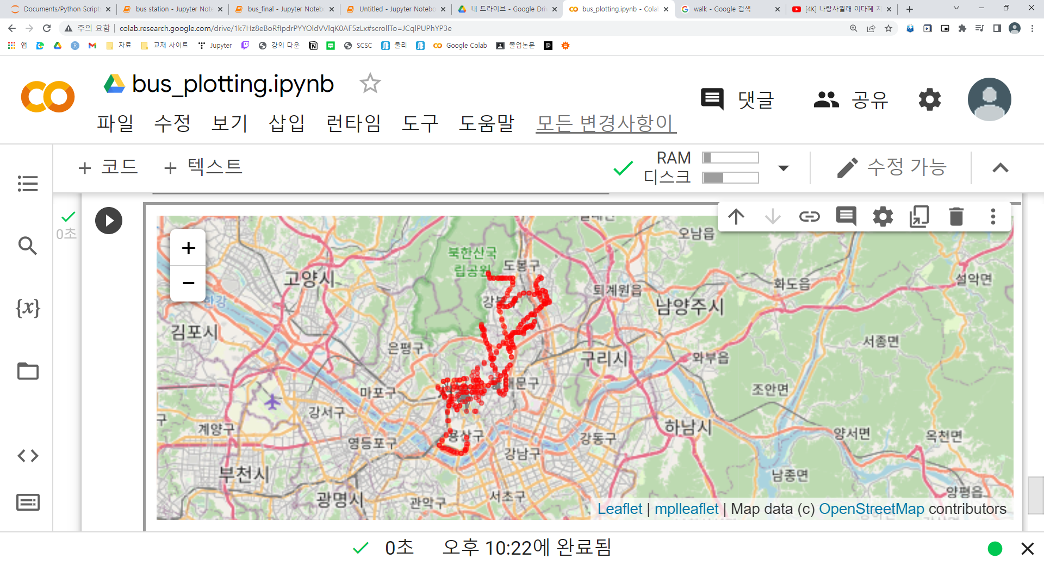
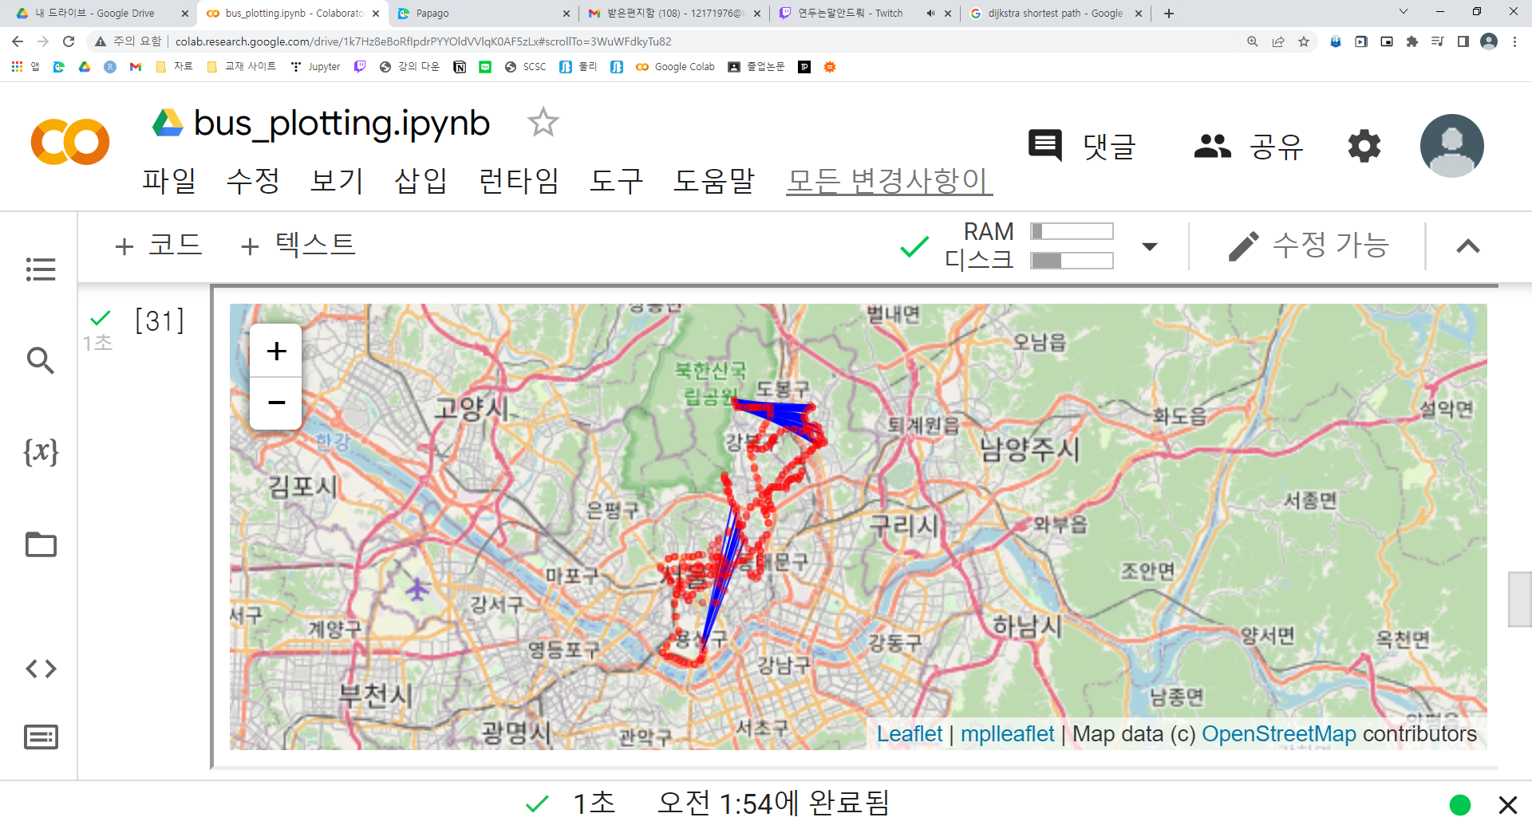
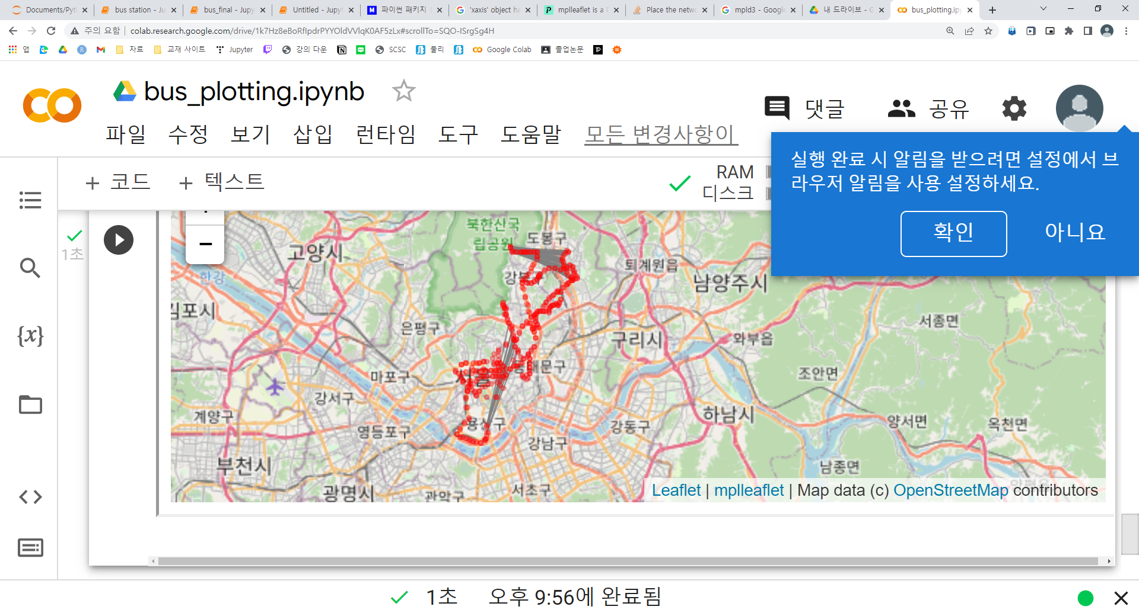
results
It allows people to travel between stops within 200 meters.
The blue line is any pair of stops with an r greater than 3 and a distance greater than 1.3 km.

Slide 8
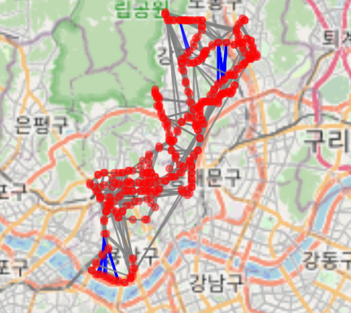
results
A
The gray line represents the bus route.
Inefficient sections A, B, and C could be extracted as illustrated.
B
c

Slide 9
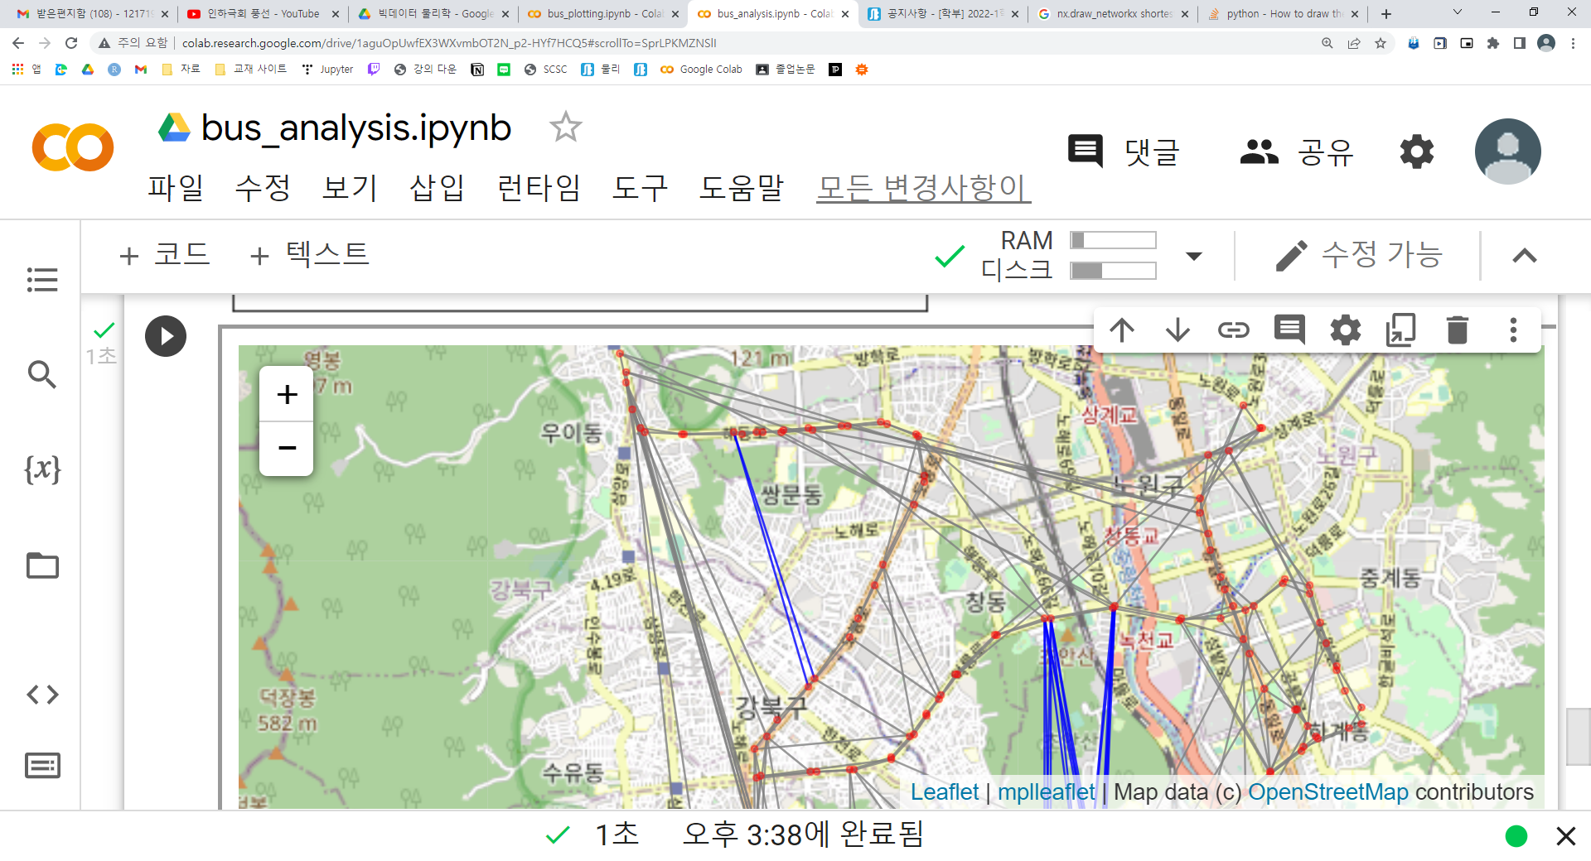
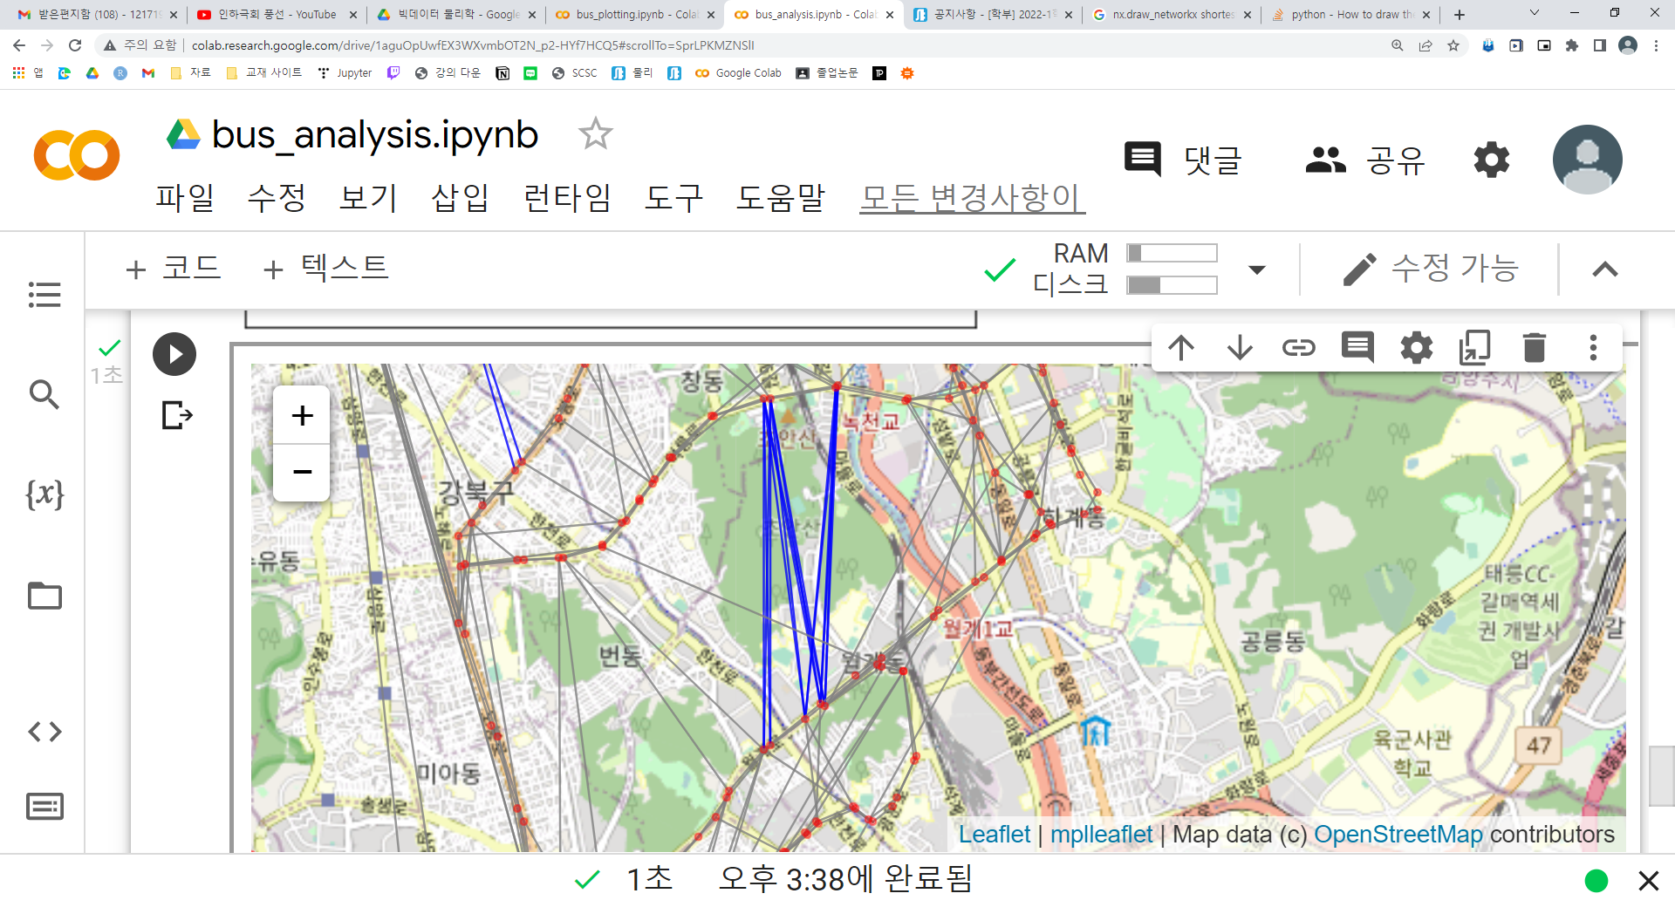
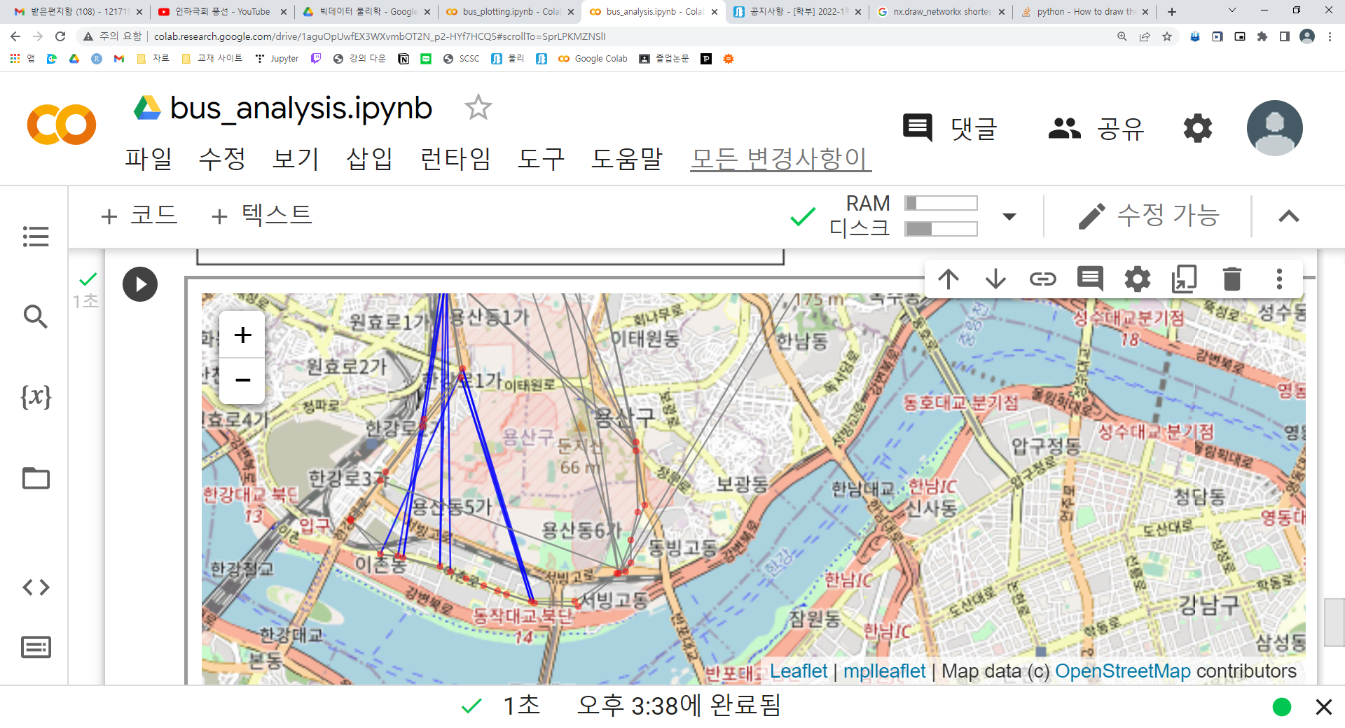
conclusion
A
B
C
Mountain
U.S. military base in Yongsan
This route has to go through residential areas. We need a route through the residential area.
This route passes through the mountain. However, there is a road between the mountains, so a bus route between the mountains is needed.
This route passes through a military base. It's an unavoidable case.

